Slide 1


CSS Bootstrap Framework
Bootstrap is a free and open-source CSS framework that designed for building responsive mobile-first websites and web applications. It is one of the most popular CSS frameworks. Bootstrap help developers to create mobile-first, adaptive web designs that work seamlessly across all devices and screen sizes.
Bootstrap offers a comprehensive set of pre-designed components, utilities, and grid systems that simplify web development, enabling developers to quickly create consistent and visually appealing user interfaces.
Bootstrap has evolved into a widely-used framework, ensuring compatibility with major browsers like Internet Explorer, Firefox, and Chrome.

Slide 2
History and Evolution
Bootstrap was created by Mark Otto and Jacob Thornton at Twitter in 2011. It was released as an open-source project, quickly gaining traction for its user-friendly and adaptable framework.
Bootstrap 1.0 introduced a responsive grid system and basic components. Subsequent versions, including Bootstrap 2.0 and 3.0, enhanced its features with more sophisticated components, improved grid systems, and mobile-first design principles.
The release of Bootstrap 4.0 marked a significant shift with Flexbox support and updated design elements.
The latest version, Bootstrap 5.0, further refines the framework with improved customization options and new utilities, reflecting its ongoing evolution to meet modern web design needs.

Slide 3
Key Features of Bootstrap
Mobile-First Approach
Bootstrap prioritizes mobile devices by default, ensuring a good user experience on smaller screens before scaling up for larger devices.
Pre-Built Components
Bootstrap provides a rich library of pre-built components like Buttons, Forms, Navigation bars, Modals, Alerts, and more, allowing developers to rapidly build functional interfaces.
Responsive Grid System
Bootstrap's grid system is designed to create responsive layouts that adapt to different screen sizes, ensuring optimal viewing on various devices.
JavaScript Plugins
Bootstrap includes a variety of JavaScript plugins that enhance user interactions and functionality, such as modals, tooltips, Popovers, Collapse and carousels.
Customization
While Bootstrap offers a default set of styles and components, it’s highly customizable. You can change the colors, fonts, and other aspects of the framework to match project branding or style.
Free and Open-Source
Bootstrap is available for anyone to use and modify, making it accessible to developers of all levels.

Slide 4
Bootstrap Grid System
Structure: Rows and Columns for Responsive Layouts
The Bootstrap grid system is designed to create flexible, responsive layouts using rows and columns.
Rows: Contain columns and ensure proper alignment and padding.
Columns: Divide the row into a maximum of 12 equal parts, which can span different widths depending on screen size.
Responsive Breakpoints
Bootstrap uses predefined breakpoints to adjust layouts across devices:
Extra Small (xs): For screens <576px.
Small (sm): For screens ≥576px.
Medium (md): For screens ≥768px.
Large (lg): For screens ≥992px.
Extra Large (xl): For screens ≥1200px.
Each column class is defined as .col-{breakpoint}-{number}:
{breakpoint}: Represents the screen size (e.g., sm, md).
{number}: Specifies how many of the 12 grid columns the element spans.
Class | Description
col-xs-* | Extra small devices (phones)
col-sm-* | Small devices (tablets)
col-md-* | Medium devices (desktops)
col-lg-* | Large devices (large desktops)

Slide 5
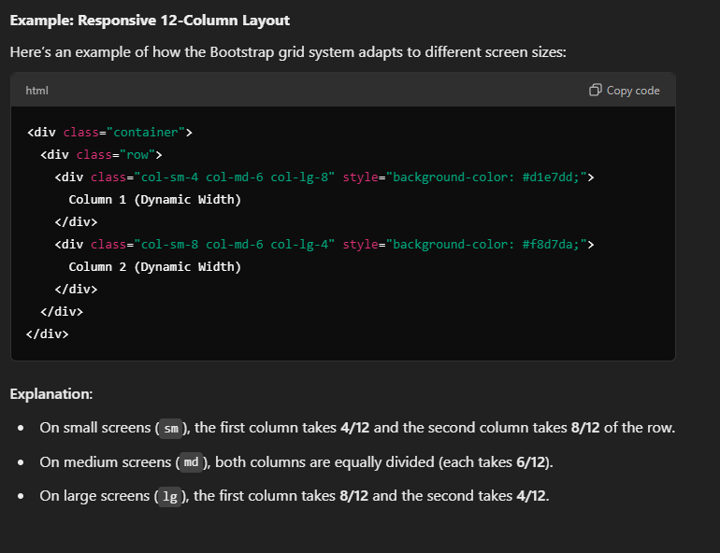
Bootstrap Grid Example

Slide 6
Bootstrap Components
Bootstrap provides a variety of pre-built components that help developers quickly and effectively create interactive and visually appealing web interfaces. Here are the key components:
Key Benefits of Bootstrap Components
Consistency: Ensures uniform design across pages.
Customization: Classes allow easy modification of appearance.
Responsiveness: Automatically adapts to various screen sizes.
Component | Description
Buttons | Predefined styles for buttons like .btn-primary, .btn-secondary, .btn-success, etc., for consistent actions.
Forms | Styled input fields, checkboxes, radio buttons, and form groups to create responsive, uniform forms with validation feedback.
Navigation Bars | Fully responsive navigation bars for headers and footers. Supports expandable menus, collapsible sections, and branding links.
Cards | Flexible containers for content with options for headers, footers, images, and links, used for displaying profiles, articles, and product details.

Slide 7
Bootstrap Typography and Icons
Typography
Bootstrap provides extensive built-in styles for text formatting, ensuring consistency and ease of use in web design. These include:
Headings: Bootstrap supports headings from h1 to h6. You can use the corresponding classes (h1, h2, …, h6) to style headings.
Text alignment: Use classes like text-left, text-center, text-right, and text-justify to align text horizontally.
Font sizes: Bootstrap offers various font size classes, such as fs-lg, fs-md, fs-sm, and fs-xs, to control text size.
Line heights: Use classes like lh-lg, lh-md, lh-sm, and lh-xs to adjust line heights.
Text color: Bootstrap provides a range of text color classes, including text-primary, text-secondary, text-success, text-danger, text-warning, and text-muted.
Icons
Bootstrap includes a set of open-source icons called Bootstrap Icons, which are designed to be used alongside Bootstrap CSS. Here are some key features:
Icon classes: Use classes like bi bi-icon-name (e.g., bi bi-plus) to add icons to your HTML elements.
Icon font: Bootstrap Icons use a font-based approach, which means icons are rendered as Unicode characters. This provides better accessibility and scalability.
Icon sizes: Bootstrap Icons support various icon sizes, including bi-lg, bi-md, bi-sm, and bi-xs.
Icon spacing: Use classes like bi-spacing-lg, bi-spacing-md, bi-spacing-sm, and bi-spacing-xs to adjust icon spacing.
Icon combinations: Bootstrap Icons allow you to combine multiple icons within a single element, making it easy to create complex icon-based components.

Slide 8
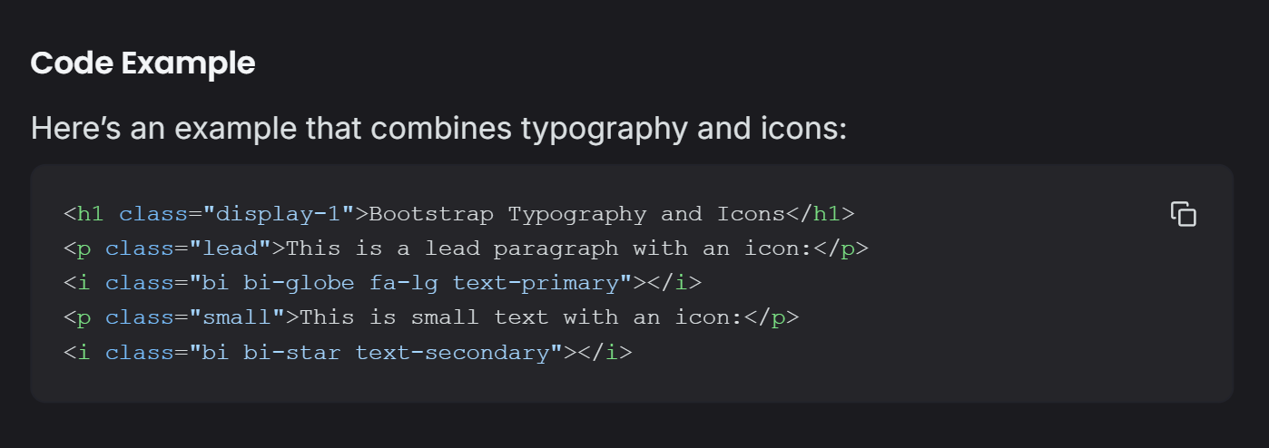
Bootstrap Typography and Icons

Slide 9
Bootstrap Utilities
Bootstrap utilities are small, single-purpose classes designed to simplify common CSS tasks such as spacing, coloring, and layout adjustments. These utilities make web development faster and more efficient.
Spacing
Bootstrap provides classes to quickly adjust margins and padding for elements:
Margins (m-*): Control the space outside an element.
Padding (p-*): Control the space inside an element.
Syntax:{property}-{sides}-{size}
property: m (margin) or p (padding)
sides: t (top), b (bottom), l (left), r (right), x (horizontal), y (vertical), or blank (all sides).
size: A number from 0 to 5 where 0 is no space, and 5 is the largest.
Colors
Bootstrap includes predefined color classes for text and backgrounds:
Text Colors: .text-primary, .text-success, .text-danger, etc.
Background Colors: .bg-primary, .bg-success, .bg-danger, etc.

Slide 10
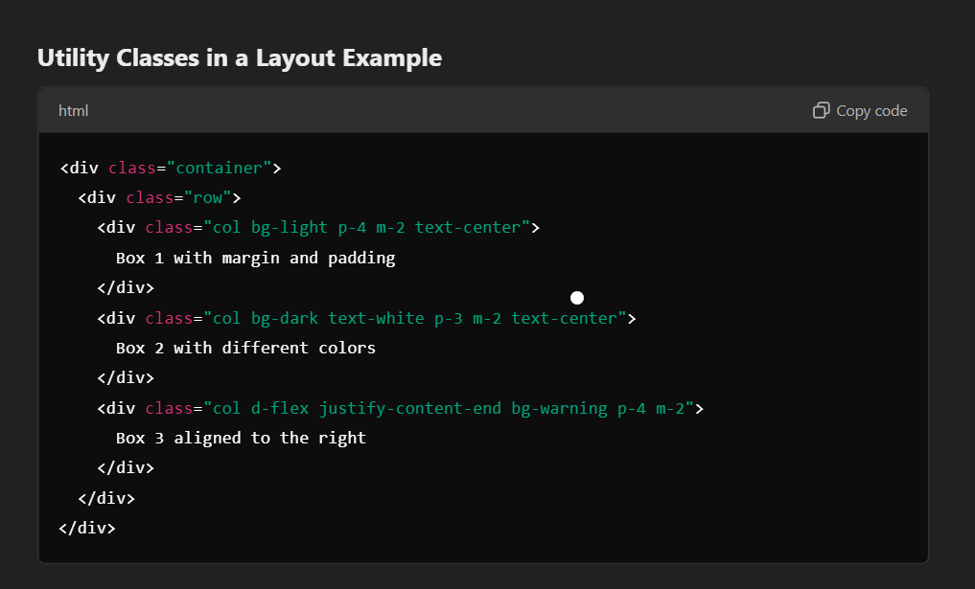
Bootstrap Utilities
Display and Flex Utilities
Display Classes: Control the display property of elements, such as .d-block, .d-inline, .d-none, etc.
Flexbox Utilities: Easily build flexible layouts with classes like .d-flex, .justify-content-center, .align-items-start, etc.

Slide 11


Advantages and Disadvantages of Bootstrap
Bootstrap offers numerous advantages, but it also has some limitations that developers should be aware of. Here is an overview of its pros and cons.
Advantages
Disadvantages
Saves development time, provides a consistent design, simplifies responsive design, offers a wide range of pre-built components, and is a widely supported framework.
Limited customization options, potential for conflicts with custom CSS, can be bulky, and may require additional learning.

Slide 12
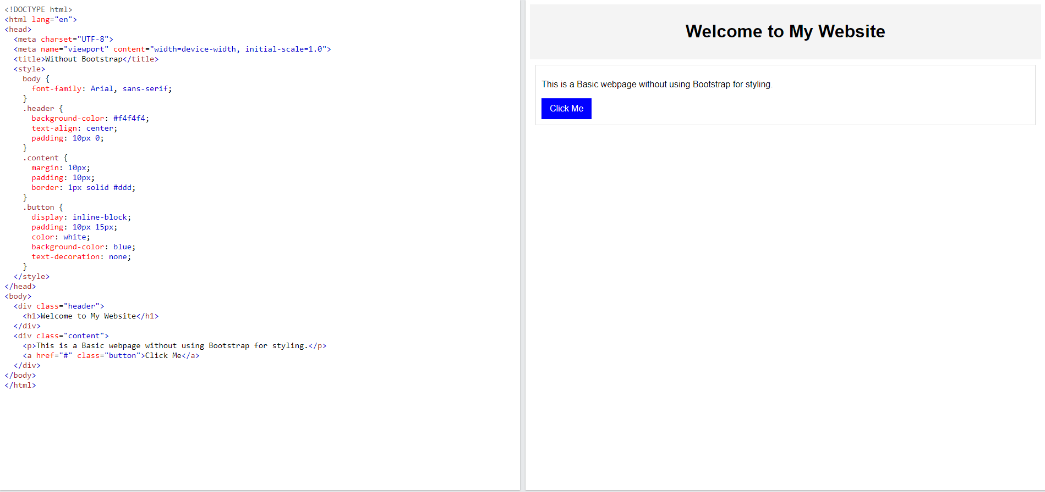
Bootstrap in Action
Before using Bootstrap: Basic HTML Code with Output

Slide 13
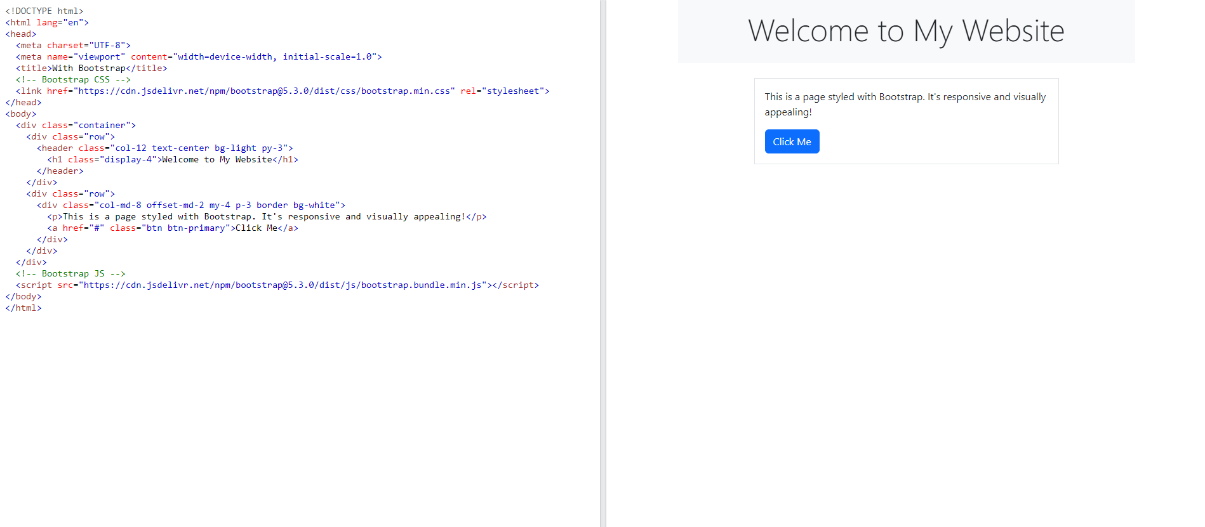
Bootstrap in Action
After Applying Bootstrap: HTML Code using Bootstrap with Output

Slide 14
Resources and Getting Started
Official Documentation
The official Bootstrap Documentation is the most comprehensive resource. It includes:
Installation Guides: Step-by-step instructions for integrating Bootstrap into your project.
Components and Utilities: Examples and explanations of pre-built components and utility classes.
Customizing Bootstrap: Guides to modify Bootstrap for your unique project requirements.
CDN and Installation
Bootstrap can be integrated into your project through multiple methods:
1. Using a CDN (Content Delivery Network) CDN integration is the quickest way to get started:
<link href="https://cdn.jsdelivr.net/npm/bootstrap@5.3.0-alpha3/dist/css/bootstrap.min.css" rel="stylesheet">
<script src="https://cdn.jsdelivr.net/npm/bootstrap@5.3.0-alpha3/dist/js/bootstrap.bundle.min.js"></script>
2. Installing with npm (Node Package Manager) For advanced users who prefer modularity and build tools:
bash:
npm install bootstrap
3. Downloading Source Files Bootstrap’s official website allows you to download its source files for offline use.

